Slide 1
BGP Simulator
Protocol Processing
Spring 2017
Group 8
Niko Hellgren

Slide 2
Contents
Technical specification and limitations
Program architecture
BGP session initialization
Routing engine
Trust implementation

Slide 3
Technical specification
Implemented in Java (built-in libraries + GraphStream graph plotting library for visualization purposes)
Strongly threaded
Inter-router data transmission (L1 & L2) using Java’s Stream classes
L3 implementation based on IPv4…
…Although not using all the available fields
No packet fragmentation support
No different types of service
No differentiation between protocols

Slide 4
Technical specification
BGP router data transmission using BGP-4
For necessary but not essential features, a globally available state is present
DNS-like feature for resolving router addresses
PKI-like feature for distributing public keys used in trust voting
Static functionality to start the connecting process of two routers
To simulate traffic in the network, clients with pinging ability attached to the routers

Slide 5
Technical limitations
Emphasis of the simulation is in BGP
The notion of Autonomous System (AS) is absorbed into routers, and each AS consists of only one router and its connected users
TCP is not implemented, BGP messages are transmitted as IP packet payload
Attacks and vulnerabilities based on TCP features are not present

Slide 7
Program architecture
bgp.simulation.SimulatorState
Global state; contains router and client registry, DNS-like functionality to map addresses to routers, and PKI-functionality for trust voting
bgp.core.BGPRouter
Base class for routers
Each instance is given a unique ID and a subnet
Provides a DHCP-like functionality to connected clients
Contains.
A list of ASConnection objects representing the connections to other routers
RoutingEngine responsible for routing decisions and routing table
TrustEngine responsible for calculating and voting on trust

Slide 8
Program architecture
bgp.core.ASConnection
Represents a connection to another BGPRouter
Contains the finite state machine, and timers for checking and sending KEEPALIVE messages
Handles the connection initialization process
Generates new OPEN, KEEPALIVE and NOTIFICATION messages
bgp.core.network.InterRouterInterface
Provides the L1/L2 functionalities for ASConnection
Uses Java’s built-in PipedInputStream and PipedOutputStream classes
Transfers data as a byte stream, prepended by the length of the packet
Passes received packets to BGPRouter for routing

Slide 9
Program architecture
bgp.core.routing.RoutingEngine
Handles UPDATE messages, decides the routing paths and keeps up the routing table
bgp.core.trust.TrustEngine
Calculates trust values for neighbours, constructs and responds to TRUST messages
bgp.client.BGPClient
Represents the clients attached to the network for testing purposes
Connected to a single BGPRouter, receives an IP address from it
Capable of responding to ping requests

Slide 10
Program architecture
bgp.utils.Address
Address and its subclass Subnet represent the IP addresses and subnets, can be converted to byte or long representation
bgp.utils.PacketEngine
Functionalities regarding the construction, modification and validation of IPv4 packets

Slide 11
BGP session initialization
Create a new ASConnection
Connect the InterRouterInterfaces’ streams
Set the FSM to state CONNECT
Send an OPEN message, retry until a KEEPALIVE is received or 10 retries have been done
Wait (independently of the previous steps) for OPEN message. Once received, start sending and checking KEEPALIVE messages
After KEEPALIVE is received, change state to ESTABLISHED
Send own routing table information to the other party, start using the connection for packet routing

Slide 12
Routing engine – Decision process
Validate the received UPDATE message
FOR EACH withdrawn route
IF exactly matching subnet in routing table is not found
Do nothing
ELSE IF the first hop on the UPDATE message matches the first hop of current best path
Remove the routing information for the subnet
Store the subnet to be sent to other neighbours
ELSE
Store the information about own best path to revoked subnet to be sent to the revoking peer after processing

Slide 13
Routing engine – Decision process
FOR EACH NLRI row
IF no exact subnet match is found from routing table
Create a new subnet node to routing table with sending router as first hop
ELSE IF local preference values of existing and new routes’ first hops differ
Store the preferred route to routing table
ELSE IF trust-scaled path lengths of existing and new routes’ differ
Store the shorter route to routing table
IF selected path was changed
Store new routing information to be sent to other neighbours

Slide 14
Routing engine – Decision process
Modify the UPDATE message:
Add own ID to AS_PATH
Remove revoked routes that caused no changes to routing table
Remove NLRI entries that caused no changes to routing table
FOR EACH neighbour not in the AS_PATH
Set NEXT_HOP to the address of the interface used to communicate with neighbour
Send the UPDATE message to neighbour
IF withdrawn routes that did not modify routing table exist
Send UPDATE message containing NLRI for these subnets to the revoking neighbour

Slide 15
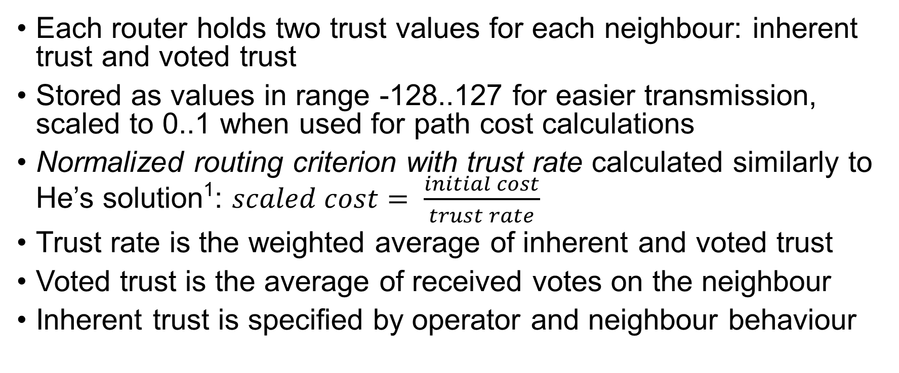
Trust implementation
Each router holds two trust values for each neighbour: inherent trust and voted trust
Stored as values in range -128..127 for easier transmission, scaled to 0..1 when used for path cost calculations
Normalized routing criterion with trust rate calculated similarly to He’s solution¹: $scaled cost= \frac{initial cost}{trust rate}$
Trust rate is the weighted average of inherent and voted trust
Voted trust is the average of received votes on the neighbour
Inherent trust is specified by operator and neighbour behaviour

Slide 16
Trust implementation – Voting
Voting is done via specific TRUST messages
As no BGP session to the voter is established, the messages are not BGP messages per se, but should be considered as ordinary UDP datagrams
Messages consist of a flag specifying if they are vote requests or responses, voted ID and target ID. If the vote is a response, the message also contains the vote (encrypted using 1024-bit RSA), and a signature. Public keys are provided by the global state.

Slide 17
Trust implementation – Voting
Voting is triggered by UPDATE messages with more than one host in the AS_PATH
A vote request is sent to the second-order neighbour in the AS_PATH list and a token is stored to ensure only one vote per request is accepted
The second-order neighbour responds by taking the trust value, padding the single-byte vote with random bits to avoid brute-force attacks, encrypts the vote using requester’s public key, signs the encrypted vote with own private key and sends the response back
The original requester checks that the token has not yet been used, validates the signature and decrypts the payload
Extracted trust value is then calculated to the averaged voted trust

Slide 18
Demo

